Slide 1

P peline
The Data
Uncertain Data
© Jennifer Mankoff
The Data Pipeline; HCII; Spring 2014

Slide 2
What causes Uncertainty?
We don’t know the provenance of data
Measurement errors
Imprecise mappings (changing scale for example)
Machine learning!

Slide 3
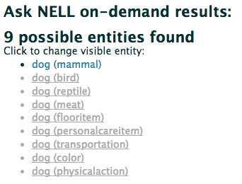
Example: Web information extraction
Nell: http://rtw.ml.cmu.edu/rtw/kbbrowser/

Slide 4

Example:
Human Input
“email Mary”
4
Notes:
I mean, Google’s latest augmented reality gadget is probably as smart as you can get
Further, the company itself has probably the most resources possible to be smart.
I mean, this Google glass sure seems pretty smart to me. but, let’s consider what would most likely happen if this lady using glass would say “email Mary”, for example

Slide 5
Phrase | Confidence
“email Gary” | 0.5
“email Mary” | 0.4
“email Harry” | 0.1
Contact | Frequency
Gary | Rarely
Mary | Daily
Harry | Rarely
5
Notes:
Let’s assume that the gesture recognition system returns something like this...
But also that Gary is contacted quite infrequently, and actually Mary is the one that gets contacted the most.
Despite this, the system would most likely email Gary anyway, since that recognized phrase has the highest confidence
But, the smarter idea woudl most likely be to email Mary, since she gets emailed daily

Slide 6
Modeling Uncertainty
Fuzzy sets

Slide 7
Modeling Uncertainty
Fuzzy sets
Dempster-Shafer theory [Zadeh, 1986]

Slide 8
Dempster-Shafer
Generalizes Bayes Theory
Models confidence for one question based on the probability other things are true
Allows for ignorance as well as knowledge by modeling degree of belief in something
Notes:
Belief (usually denoted Bel) measures the strength of the evidence in favor of a set of propositions s. It ranges from 0 (indicating no evidence) to 1 (denoting certainty).
Plausibility (denoted by Pl) is defined to be Pl(s)=1-Bel(~s). It also ranges from 0 to 1 and measures the extent to which evidence in favor of ~s leaves room for belief in s.

Slide 9
Example: Cat in a box
Hypothesis | Mass | Belief | Plausibility
Neither alive nor dead | 0 | 0 | 0
Alive | 0.2 | 0.2 | 0.5
Dead | 0.5 | 0.5 | 0.8
Either (Alive or Dead) | 0.3 | 1.0 | 1.0

Slide 10
Example: Cat in a box
Hypothesis | Mass | Belief | Plausibility
Neither alive nor dead | 0 | 0 | 0
Alive | 0.2 | 0.2 | 0.5
Dead | 0.5 | 0.5 | 0.8
Either (Alive or Dead) | 0.3 | 1.0 | 1.0
Null Hypothesis – ‘no solution’ is 0

Slide 11
Example: Cat in a box
Hypothesis | Mass | Belief | Plausibility
Neither alive nor dead | 0 | 0 | 0
Alive | 0.2 | 0.2 | 0.5
Dead | 0.5 | 0.5 | 0.8
Either (Alive or Dead) | 0.3 | 1.0 | 1.0
Reliability of signals that cat is alive or dead

Slide 12
Example: Cat in a box
Hypothesis | Mass | Belief | Plausibility
Neither alive nor dead | 0 | 0 | 0
Alive | 0.2 | 0.2 | 0.5
Dead | 0.5 | 0.5 | 0.8
Either (Alive or Dead) | 0.3 | 1.0 | 1.0
Ensures sum of masses is 1

Slide 13
Example: Cat in a box
Hypothesis | Mass | Belief | Plausibility
Neither alive nor dead | 0 | 0 | 0
Alive | 0.2 | 0.2 | 0.5
Dead | 0.5 | 0.5 | 0.8
Either (Alive or Dead) | 0.3 | 1.0 | 1.0
Matches because they have no subsets

Slide 14
Example: Cat in a box
Hypothesis | Mass | Belief | Plausibility
Neither alive nor dead | 0 | 0 | 0
Alive | 0.2 | 0.2 | 0.5
Dead | 0.5 | 0.5 | 0.8
Either (Alive or Dead) | 0.3 | 1.0 | 1.0
Sum of all three masses that relate to ‘either’

Slide 15
Example: Cat in a box
Hypothesis | Mass | Belief | Plausibility
Neither alive nor dead | 0 | 0 | 0
Alive | 0.2 | 0.2 | 0.5
Dead | 0.5 | 0.5 | 0.8
Either (Alive or Dead) | 0.3 | 1.0 | 1.0
1 – m(Dead)

Slide 16
Example: Cat in a box
Hypothesis | Mass | Belief | Plausibility
Neither alive nor dead | 0 | 0 | 0
Alive | 0.2 | 0.2 | 0.5
Dead | 0.5 | 0.5 | 0.8
Either (Alive or Dead) | 0.3 | 1.0 | 1.0
1 – m(Alive)

Slide 17
Example: Cat in a box
Hypothesis | Mass | Belief | Plausibility
Neither alive nor dead | 0 | 0 | 0
Alive | 0.2 | 0.2 | 0.5
Dead | 0.5 | 0.5 | 0.8
Either (Alive or Dead) | 0.3 | 1.0 | 1.0
m(Alive) = m(Dead) + m(Either)
Notes:
Universal hypothesis acts as a checksum
----- Meeting Notes (4/17/14 10:13) -----
look up limitations of dempster shafer theory

Slide 18
Modeling Uncertainty
Fuzzy sets
Dempster-Shafer theory [Zadeh, 1986]
Probabilities p = [0, 1]

Slide 19
Advantages of probability
Mathematically rich
Lots of ways to produce them
Normalized confidence scores
May naturally arise from statistical information extraction
Can calculate based on trust in sources
Rich potential for relational data modeling

Slide 20
Modeling Uncertainty
Fuzzy sets
Dempster-Shafer theory [Zadeh, 1986]
Probabilities p = [0, 1]
Monte Carlo representations
sampled probability

Slide 21
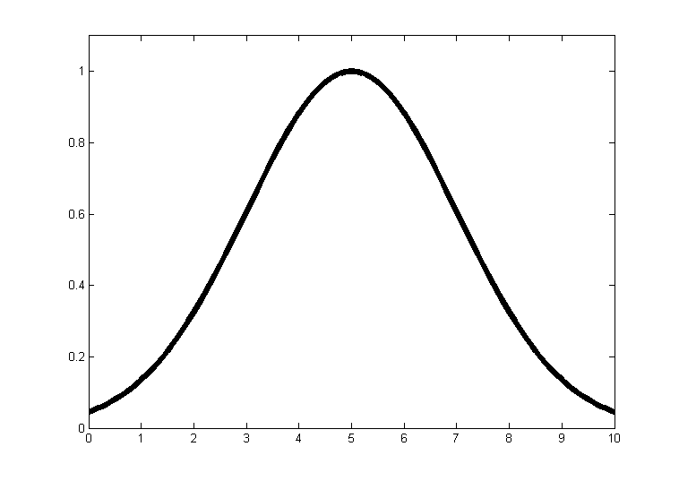
A Monte Carlo Approach
Notes:
Our system accomplishes this by simulating distributions using samples, like in Monte Carlo methods. In other words, given a probability distribution over values as seen here, we model this distribution by sampling from it many times. This collection of samples simulates the distribution over actual values.

Slide 22
A Monte Carlo Approach
1
4
5
6
8
Notes:
Our system accomplishes this by simulating distributions using samples, like in Monte Carlo methods. In other words, given a probability distribution over values as seen here, we model this distribution by sampling from it many times. This collection of samples simulates the distribution over actual values.
Approximates high probabilities well

Slide 23
Focus of Today’s Lecture
Modeling uncertainty of structured data
Trio
Modeling uncertainty in a data processing scenario
Uncertain Input Handling
Computing over uncertain data
Probabilistic Spreadsheets

Slide 24
Trio Probabilistic Relational Databases
Trio models lineage and probability
Models alternatives as tuples
Models presence/absence of tuples (‘maybe’)
Models confidence of tuple elements
Models derivation of tuples (lineage)
Queries [sql-like]
Can specify confidence interval [calculated based on lineage]
Can specify lineage
Can constrain tuple contents

Slide 25
Trio Probabilistic Relational Databases
Trio models lineage and probability
Queries [sql-like]
Extending Trio to model ignorance based on Dempster-Shafer theory
Different types of confidence: Exact/missing/imprecise/…
Types of confidence by modeling different masses for different possible knowledge (‘Worlds’)
Data is modeled as tuples (worlds, each with a mass) of tuples (alternatives)

Slide 26
Trio Probabilistic Relational Databases
Trio models lineage and probability
Queries [sql-like]
Extending Trio (Dempster-Shafer theory)
Extending Trio with continuous uncertainty
For example modeling the range and likelihood of of values that may be taken as a gaussian

Slide 27
Focus of Today’s Lecture
Modeling uncertainty of structured data
Trio
Modeling uncertainty in a data processing scenario
Uncertain Input Handling
Computing over uncertain data
Probabilistic Spreadsheets

Slide 28
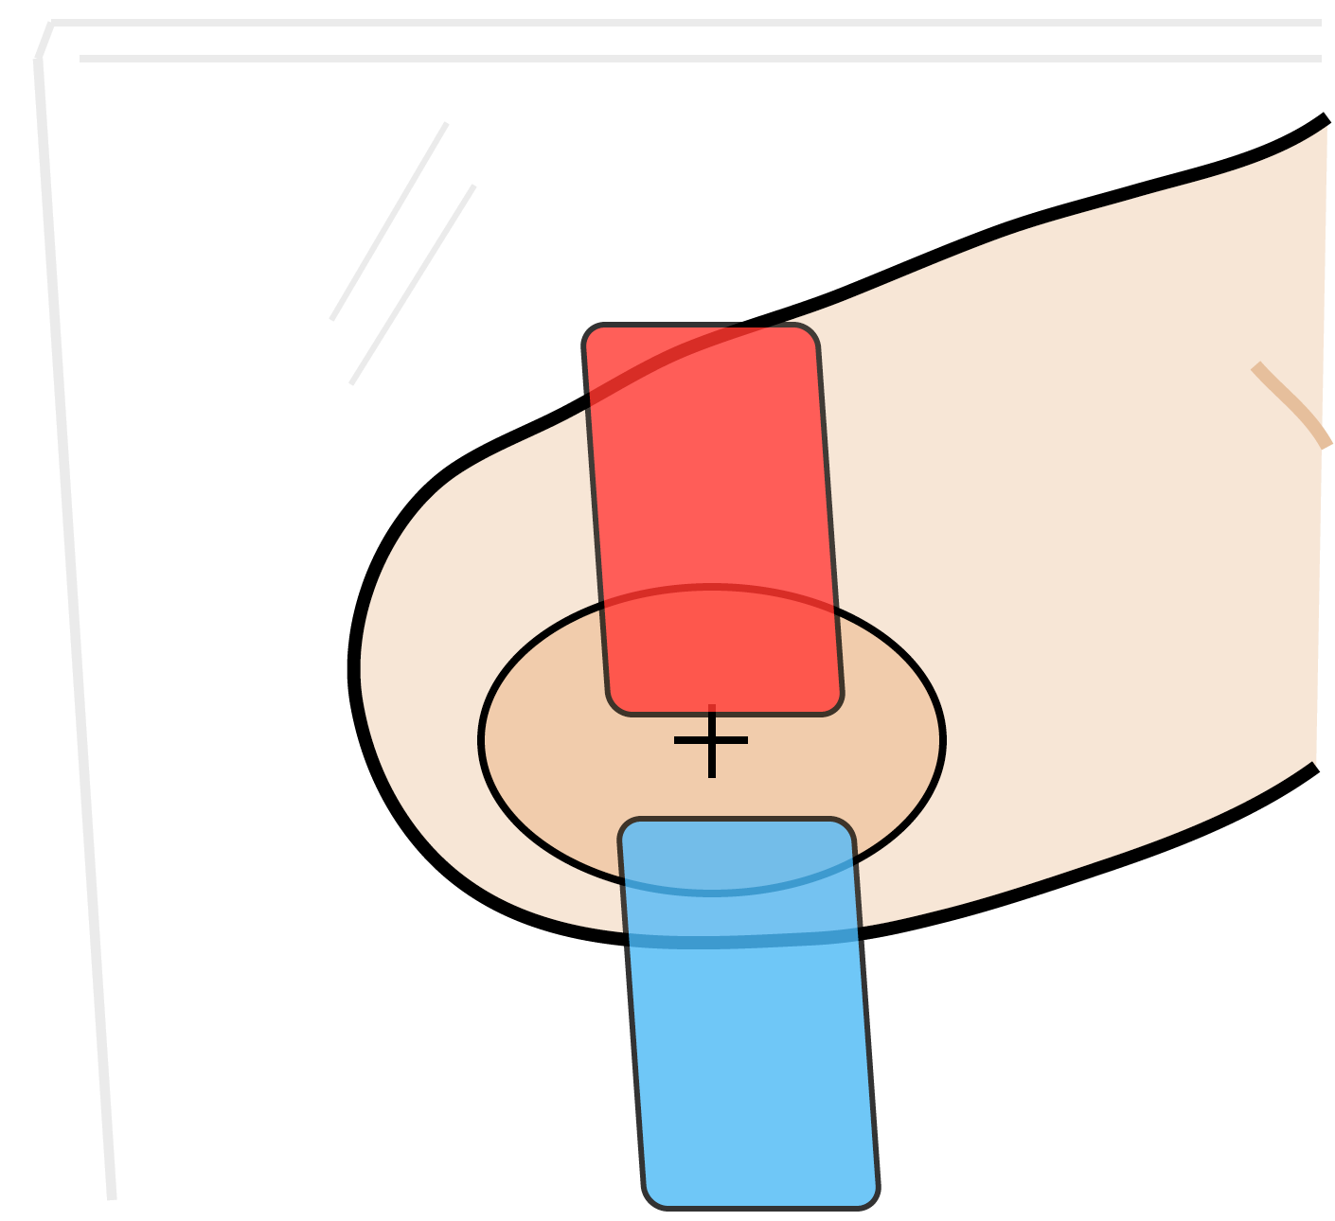
28
Notes:
Let’s take another example, this time from touch.
When we touch on the surface of a screen, we don’t touch a single point, but an entire area
Our intended touch location can be anywhere inside this touch location, or possibly even outside of it.
Yet by and large, almost all input systems boil this down to an individual point.
They don’t even give applications a chance to leverage information such as the cost of clicking incorrectly, or how often buttons are pressed.

Slide 29
29
Notes:
Let’s take another example, this time from touch.
When we touch on the surface of a screen, we don’t touch a single point, but an entire area
Our intended touch location can be anywhere inside this touch location, or possibly even outside of it.
Yet by and large, almost all input systems boil this down to an individual point.
They don’t even give applications a chance to leverage information such as the cost of clicking incorrectly, or how often buttons are pressed.

Slide 30
30
Notes:
Let’s take another example, this time from touch.
When we touch on the surface of a screen, we don’t touch a single point, but an entire area
Our intended touch location can be anywhere inside this touch location, or possibly even outside of it.
Yet by and large, almost all input systems boil this down to an individual point.
They don’t even give applications a chance to leverage information such as the cost of clicking incorrectly, or how often buttons are pressed.

Slide 31
Why aren’t interfaces smarter about uncertainty?
31
Notes:
I posit that the basic reason for why interfaces are not smarter is because user input toolkits do not deal with input alternatives, and more broadly, uncertain inputs, very well.

Slide 32
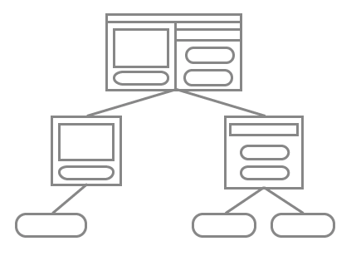
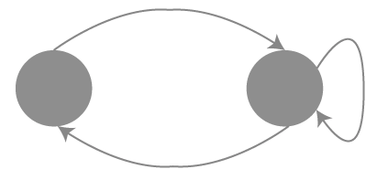


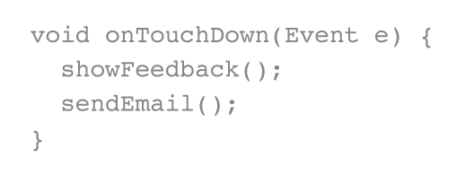

update state
dispatch
draw feedback
event callback
execute action
32
Notes:
To explain why this is the case, let’s first understand how a user interface works.
Here is a chart describing the processes that input goes through, from the moment you touch a button to when you see it light up.

Slide 33
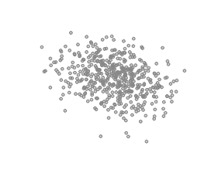
update state
dispatch
draw feedback
event callback
execute action
33
Notes:
To explain why this is the case, let’s first understand how a user interface works.
Here is a chart describing the processes that input goes through, from the moment you touch a button to when you see it light up.

Slide 34
update state
dispatch
draw feedback
event callback
execute action
34
Notes:
Let’s say there is uncertainty in the user input

Slide 35
update state
dispatch
draw feedback
event callback
execute action
35
Notes:
Right now that is all thrown out up front

Slide 36


low ambiguity
36
Notes:
This is fine for data that is not very ambiguous

Slide 37
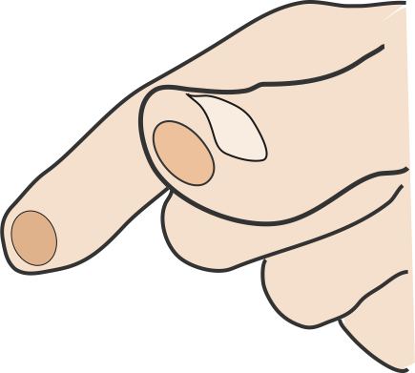
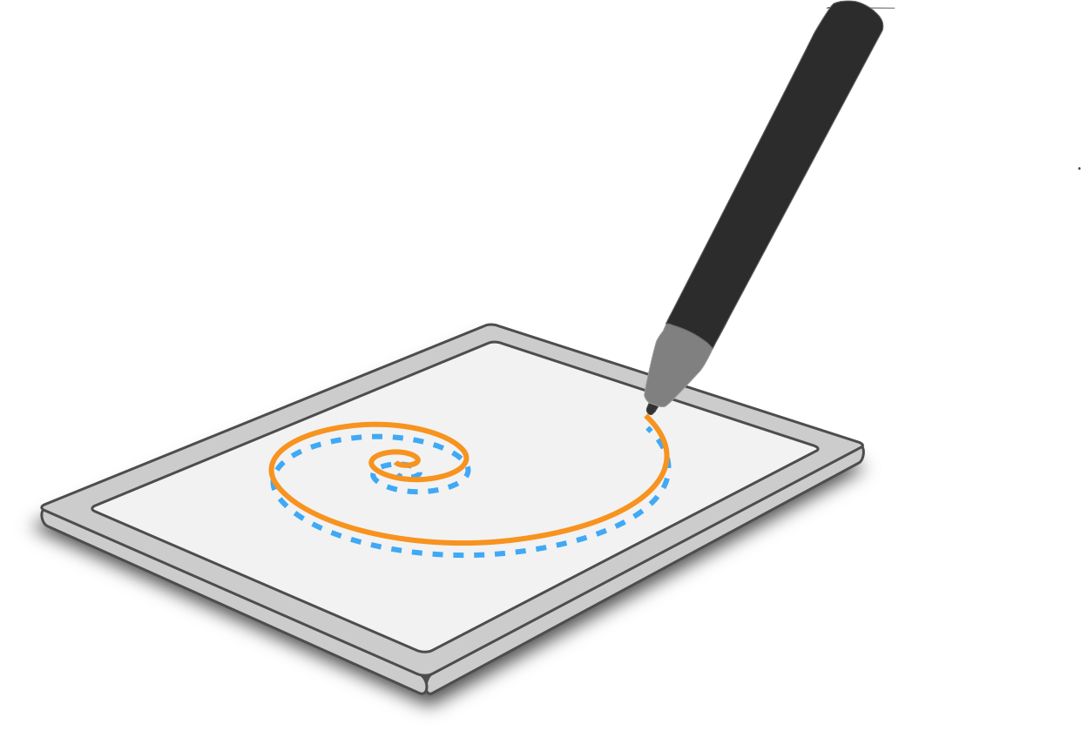

low ambiguity
high ambiguity
37
37
Notes:
Not so fine fro uncertain input

Slide 38
update state
dispatch
draw feedback
event callback
execute action
38
Notes:
Right now that is all thrown out up front

Slide 39
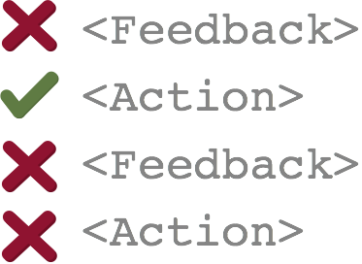
update state
dispatch
event model
draw feedback
mediation
event callback
execute action
39
Notes:
Let’s say there is uncertainty in the user input

Slide 40
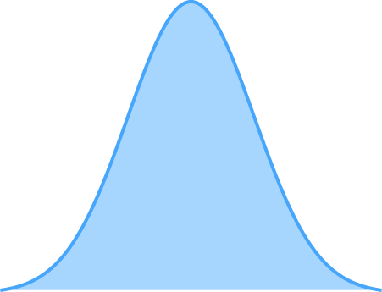
Monte Carlo Approach
40
Notes:
Well, our system our system accomplishes this by simulating distributions using samples, like in Monte Carlo methods.
In other words, given a probability distribution over values as seen here, we model this distribution by sampling from it many times. This collection of samples simulates the distribution over actual values.

Slide 41
Monte Carlo Approach
41
Notes:
In other words, given a probability distribution over values as seen here, we model this distribution by sampling from it many times. This collection of samples simulates the distribution over actual values.

Slide 42
update state
dispatch
event model
draw feedback
mediation
event callback
execute action
42
Notes:
Let’s say there is uncertainty in the user input

Slide 43
input modeling
dispatch
update state
execute action
button
doUp()
System
button
doDown()
button
doMove()
43
Notes:
When applied to input handling, this allows us to turn probability distributions in each of the input handling phases of modeling, dispatch, state monitoring, and action to a large collection of samples.
Collectively, these samples represent a distribution over values, however from the developer’s perspective, they only need to write logic for a single one of these sample.
[Juggling analogy]

Slide 44

input modeling
dispatch
update state
execute action
button
doUp()
System
button
doDown()
button
doMove()
Developer
button
doMove()
44
Notes:
When applied to input handling, this allows us to turn probability distributions in each of the input handling phases of modeling, dispatch, state monitoring, and action to a large collection of samples.
Collectively, these samples represent a distribution over values, however from the developer’s perspective, they only need to write logic for a single one of these sample.
[Juggling analogy]

Slide 45
An Example…
45
Notes:
To better explain event modeling, and more importantly the more complex later portions, I’m going to use a simple example of this draggable icon.
[describe draggable icon]

Slide 46

start
down
46

Slide 47
start
showFeedback()
down
47

Slide 48
start
down
moveIcon()
48

Slide 49
start
down
dropIcon()
49

Slide 50
TouchEvent {
float likelihood;
RandomPoint location;
}
50

Slide 51
TouchEvent {
float likelihood;
RandomPoint location;
}
51

Slide 52
TouchEvent {
float likelihood;
RandomPoint location;
}
52
Notes:
Gives a set of touch event samples, each of which then gets dispatched to individual interactors

Slide 53
53
Notes:
Let’s see what happens when we may be dragging many icons

Slide 54
iconDown()P = 0.1
iconDown()P = 0.1
iconDown()P = 0.6
iconDown()P = 0.1
iconDown()P = 0.1
moveIcon()P = 0.1
moveIcon()P = 0.1
moveIcon()P = 0.6
moveIcon()P = 0.1
moveIcon()P = 0.1
54
Notes:
To better explain event modeling, and more importantly the more complex later portions, I’m going to use a simple example of this draggable icon.
[describe draggable icon]

Slide 55
moveIcon()P = 0.1
moveIcon()P = 0.1
moveIcon()P = 0.6
moveIcon()P = 0.1
moveIcon()P = 0.1
55

Slide 56
dropIcon()P = 0.1
dropIcon()P = 0.1
dropIcon()P = 0.6
dropIcon()P = 0.1
dropIcon()P = 0.1
56
Notes:
The task of the mediation system is to decide which actions to accept, and which actions to reject

Slide 57


Mediation
dropIcon()P = 0.1
dropIcon()P = 0.1
dropIcon()P = 0.6
dropIcon()P = 0.1
dropIcon()P = 0.1
57
Notes:
And when several requests to execute action are present, it executes the most likely...

Slide 58
Goal of Mediation System...
Decide which actions to....
accept (execute)
reject (cancel execution)
defer (postpone execution)
58

Slide 59
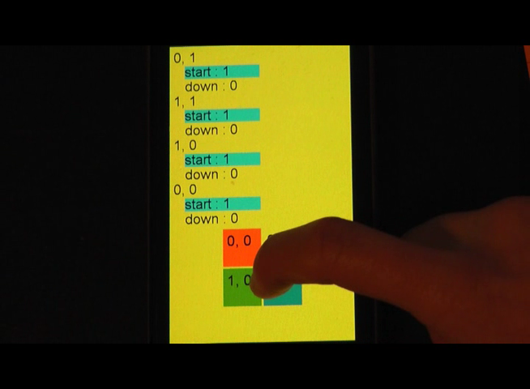
59
Notes:
Let’s look at an example...

Slide 60
Wide Applicability
Traditional uncertain input
Voice, Touch, …
New Possibilities
User error
Predicting intent
…
Notes:
What’s different about our work is it support MANY different improvements.
Why? Because we’ve abstracted uncertainty at event level, works independently of events
IMPORTANT POINT: What’s new is we’re treating events as UNCERTAIN in a systematic, reusable way.
Other solutions fix only specific things.

Slide 61
User Error: Helping People with Motor Impairments
When using a mouse, click location not equal to intent
Model click as PMF
Collected data:
100+ clicks x 4 users
Notes:
Demonstration of broad applicability of tool.
Taking same capability, using for something new. For people who have difficulty with pointing. Pointing position doesn’t accurately reflect intent.
Treat this as a new form of uncertainty.
To test this idea, we collected 419 clicks from 4 people with motor impairments
We used our framework to determing what would happen if their input was handled probabilistically. As you can see, error drops significantly when compared to conventional input.

Slide 62
Conclusion
Developed a system that simplifies development of probabilistic input interfaces.
System manages probability distributions so that developers (for the most part) don’t need to.
Notes:
This talk gave a very simple description of our input system, but hopefully it conveyed one message, which is that our system allows developers to write logic for probabilistic input without needing to think probabilistically. The system manages modeling probability distributions so that individual developers writing controls for the system don’t have to. Developers simply specify a deterministic state machine description and methods to execute, and our system does all of the heavy lifting.

Slide 63
Focus of Today’s Lecture
Modeling uncertainty of structured data
Trio
Modeling uncertainty in a data processing scenario
Uncertain Input Handling
Computing over uncertain data
Probabilistic Spreadsheets

Slide 64
Computing over uncertain data
May require dealing with uncertainty at scale (we use Monte Carlo methods here too)
Requires efficient access to and presentation of such data

Slide 65
Our Solution
Low level support for ‘reactive computing’ with uncertain data
Low level support for highly efficient parallelization of common statistical functions
Example application (probabilistic spreadsheet)

Slide 66
Probabilistic Spreadsheet Demo
Assume a MOOC instructor wishes to estimate students’ midterm grades
Knows how millions of prior students have performed on every assignment
Knows how the current students have performed so far
How can he estimate current student performance?

Slide 67
Video

Slide 68
Underlying Technology
Support for constraint-based programming
Very efficient update algorithm
Lazy (only computes when needed)
Incremental (only computes what’s needed)
Good bookkeeping
Early quiescence
Optimal handling of non-strict functions
Highly parallel server (GPU based) for function execution

Slide 69
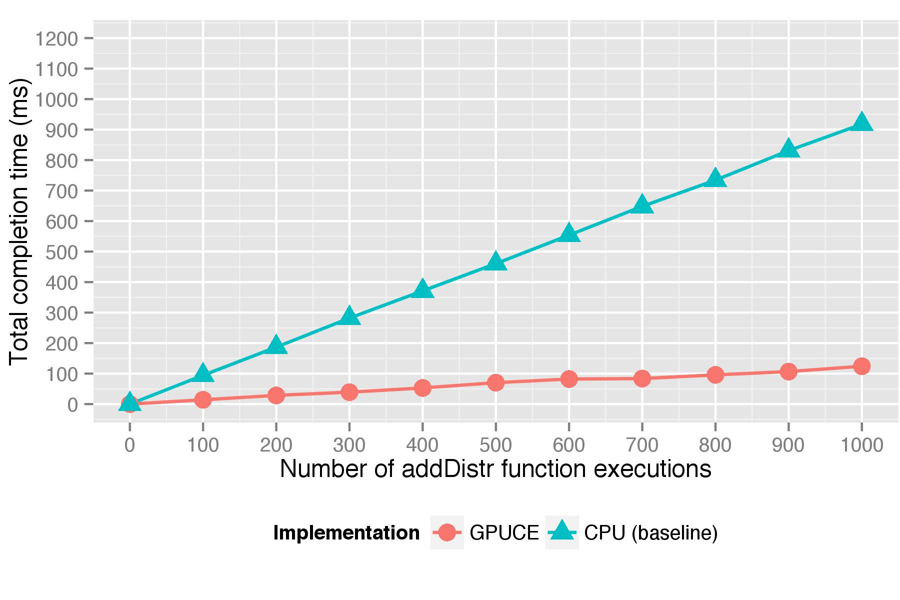
Parallelism: big performance gains

Slide 70
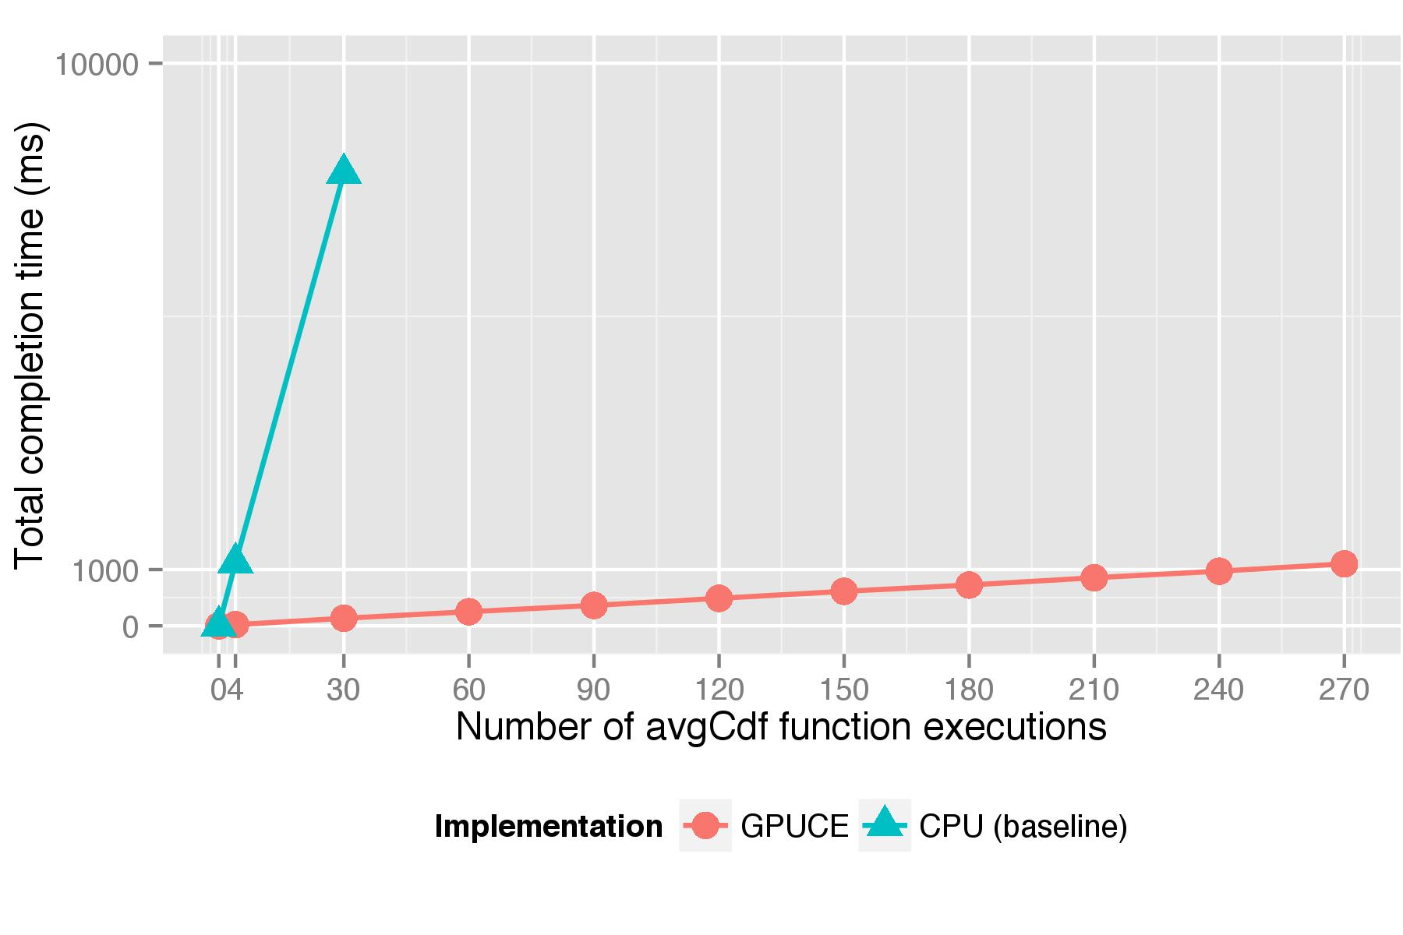
Parallelism: big performance gains

Slide 71
Tuesday meetings about final projects
Thursday final exam review and handout
Final exam is ‘backwards’
By Tuesday, 4/29
You write 5 exam questions (3 short answer, two long answer)
You answer your own questions
By Friday 5/2
You grade 25 randomly selected questions (15 short answer, 10 long answer)
I take the top 3 short answer and top 2 long answer questions!

